Slide 2
Presents
M5Ones
(knowledge is light)
CONCEPTS ON BLOCKCHAIN TECHNOLOGY

Slide 3
M5Ones Members
Shubham Guha (BCA-MCA)
Sayan Dinda (BCA)
Dipanwita Patra (HOSPITAL MANAGEMENT)
Sandip patra (BBA)
Debarshi pal (BCA)
OUR HONORABLE MENTOR – DR. HARENDRA NATH BHATTACHARYA

Slide 4
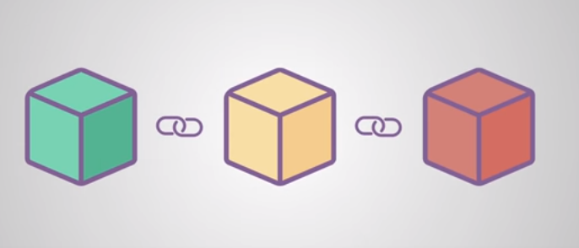
(a chain of blocks that contain information) Blockchain – a system in which record of transactions made in bitcoin or in cryptocurrency are maintain across several computers that are linked peer to peer network.

Slide 5
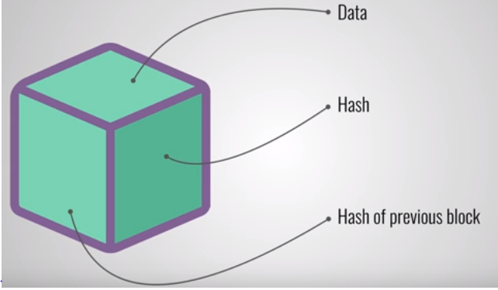
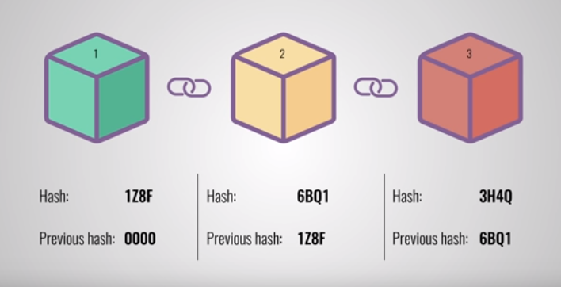
Data - include the details all about transactions hash - fingerprint ,id.etc which must be unique. Previous hash - effectively create the chain of blocks.
HASH 6BQ1 IS CONNECTED WITH PREVIOUS HASH 0000 AND SIMILARLY HASH 3H4Q IS CONNECTED WITH 1Z8F

Slide 6
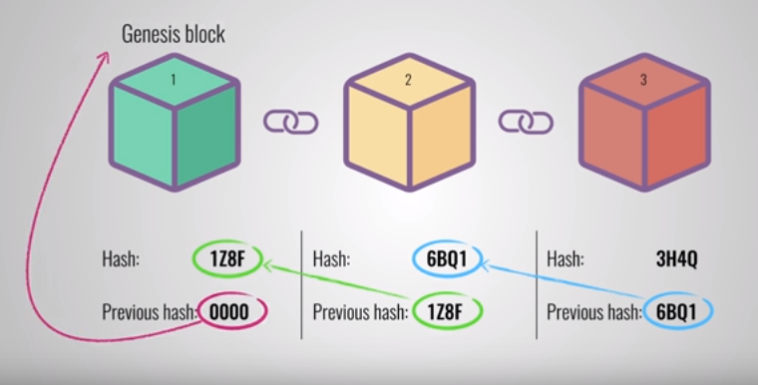
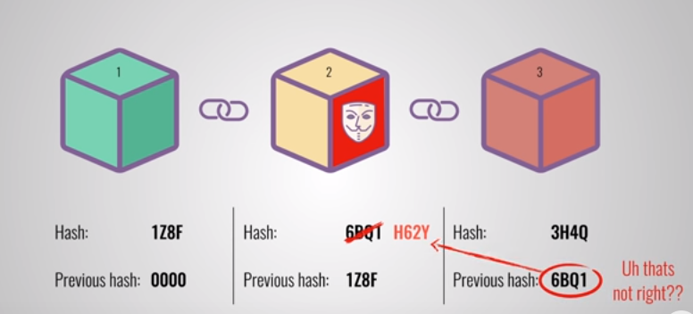

Slide 7
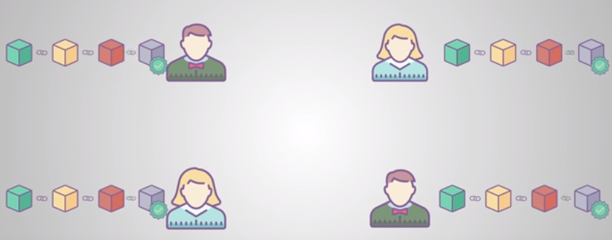
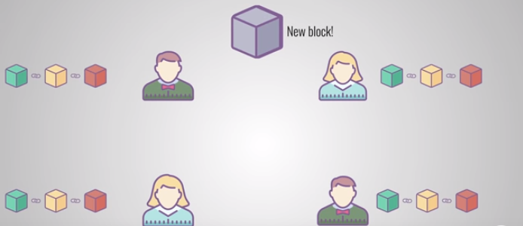
ADVANTAGES AND
DRAWBACKS OF BLOCKCHAIN
It will take a time to introduced this particular technology.
Everyone must have smartphones.
Distributing msg. about this technology.
Blockchain has something called proof of work (which slows down the creation of new blocks).
Instead of using central entity to change, it uses p2p network.
It has extremely high security.
Efficiency is also quite high(smart contracts).

Slide 8
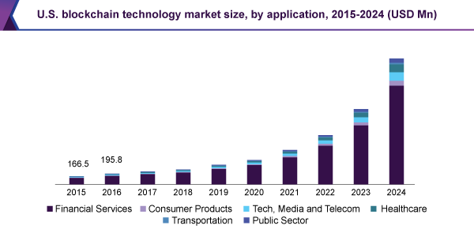
Values of Blockchain
BLOCKCHAIN IS ALSO CONSTANTLY EVOLVING
The global blockchain market size is expected to grow from USD 1.2 billion in 2018 to USD 23.3 billion by 2023.
Countries like Japan,Canada,Estonia.etc are agreed to used this technology (they all want to become blockchain nations)

Slide 9
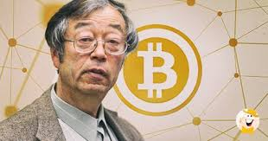
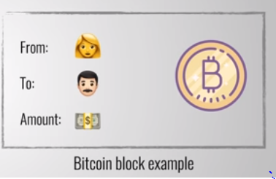
Some of the main facts of blockchain
1.Resources like time,electricity.etc are required for maintaining this types of technology.
In order to beat this, Satoshi Nakamoto(the blockchain inventor) introduced ‘BITCOIN’.
2.Blockchain follows ‘distributed trust’ which is much more trustworthy then ‘centralized trust’.
3.It also enables ‘Universal ledger’{as it connects nodes to nodes}.-[For this everyone must be authenticated]
(As every block is linked with other block)
(Satoshi Nakamoto, The founder of Bitcoin)

Slide 10
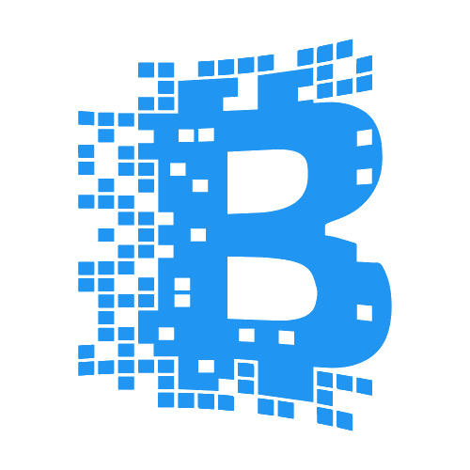
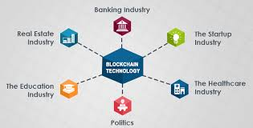
Major impacts of Blockchain (based on prediction)
Drastic change of corruption (its going to reduce in heavy rate).
It has the potential to fight against all sorts of frauds (medical records,collecting taxes,registrations results.etc).
Deserved one will always be chosen.
Efficiency on the process of voting,healthcare,education.etc going to be established with the help of this technology.
It provides proof of every work.
Tampering stuffs not work against this technology.
Smart phones will available to everyone(as major people will have the trust on this particular technology).

Slide 11
Prices of setting a Blockchain technology
It is just an assumption as it affects differently for different countries.
White Paper professionally drafted (this is FIRST; a clear vision, well explained, within legal boundaries, is ESSENTIAL in the cryptosphere).
Website/basic landing page.
Complete platform (from basic to platform/mining/wallet and payment platform with unique ERC20 token).
ERC20 token alone w/ smart contract customization as per your choice.
Once you have all of that; you need to establish a solid method of advertising and social media control. The cryptosphere is ALWAYS active; and NEVER sleeps; you’ll NEED to address that fact with a fairly large team.
ONCE ITS ESTABLISH , THE THINGS WILL BECOME EASIER TO IDENTIFY THE SOURCES REQUIRE BEHIND THIS TECHNOLOGY….
As per our country, the price will not be much as country includes various types of people….(it must affordable for everyone)..
JUST IN ORDER TO USE IT THE BASIC REQIUREMENTS MUST BE FULLFILLED BY EVERYONE…

Slide 12
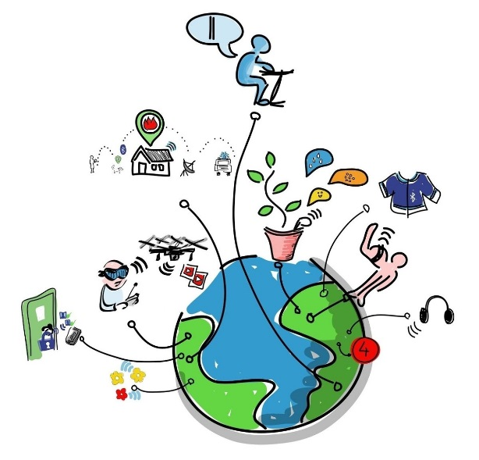
Assumptions of Blockchain
In this era, Internet plays a great role throughout the whole world as it solves everything and gives every information.
But it has 2 drawbacks – i) trust problem
ii) intermediation problem
Whereas Blockchain promises to solve both these problem, making it efficient in terms of each and everything throughout the internet and bring the p2p economy.
It gives rise to new internet in which allow – digital information to be distributed but not copied which also gives freedom of pursuit on the world of internet.

Slide 13


